Slide 1
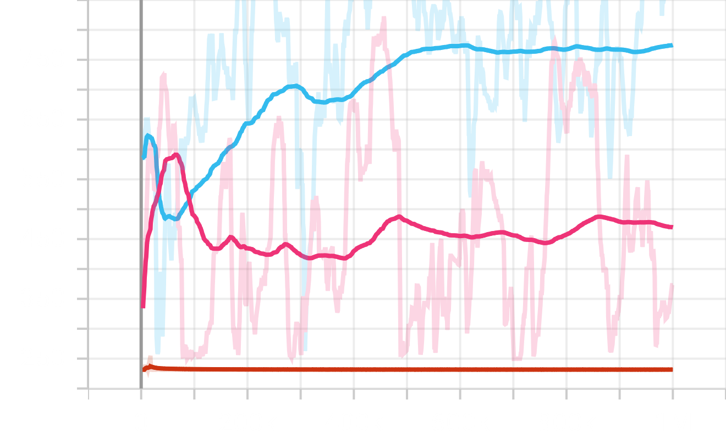
Discount Factor (A2C)
Pink 0.001;Light Blue 0.5; Red 0.99

Slide 2
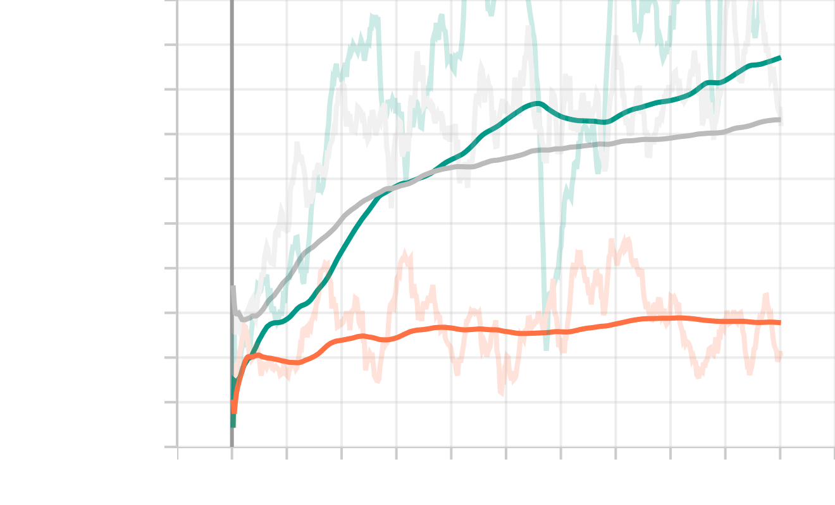
Discount Factor (PPO)
Green 0.99;Grey 0.5;Orange 0.001

Slide 3
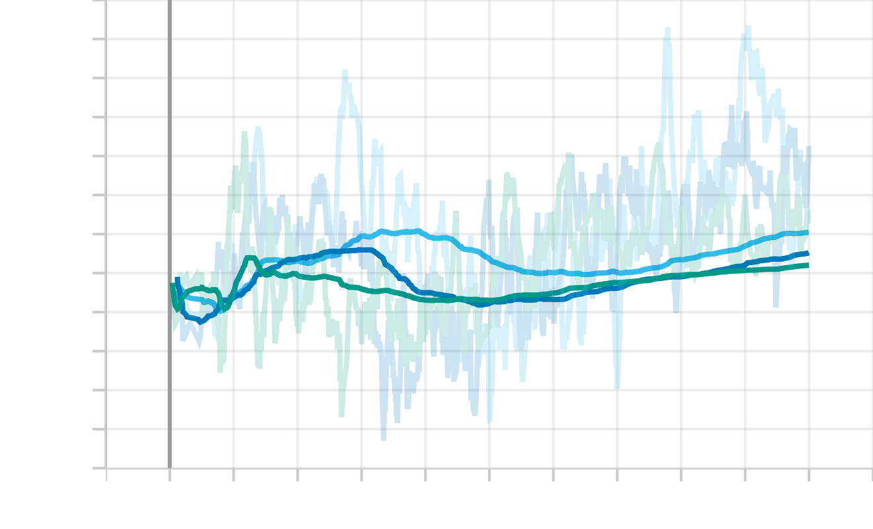
Discount Factor (DQN)
Light Blue 0.99; Blue 0.5; Green 0.001

Slide 4
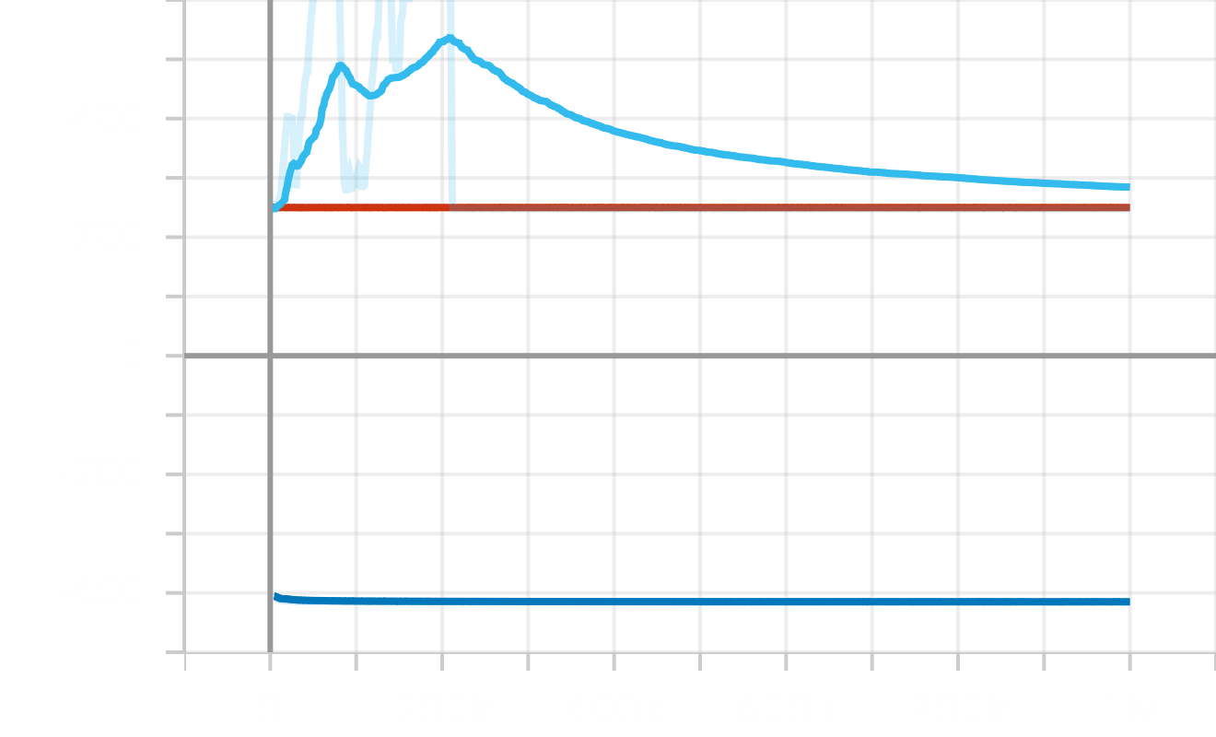
Learning Rate (A2C)
Light Blue 0.001; Red 0.5; Blue 0.99

Slide 5
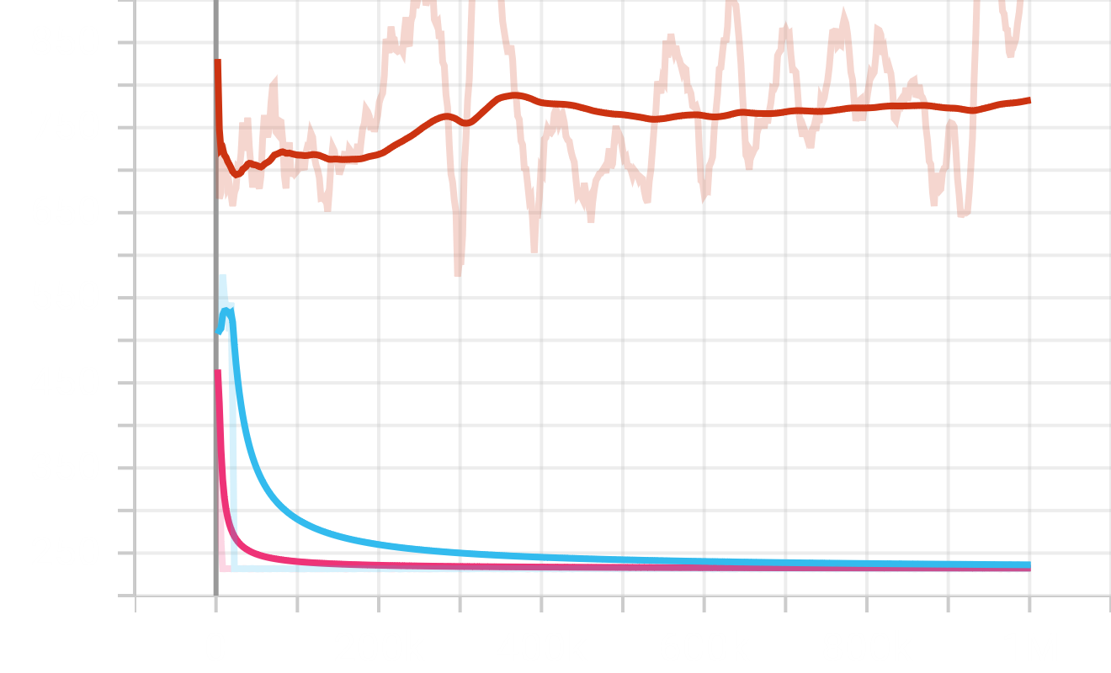
Learning Rate (PPO)
Red 0.001; Light Blue 0.5; Pink 0.001

Slide 6
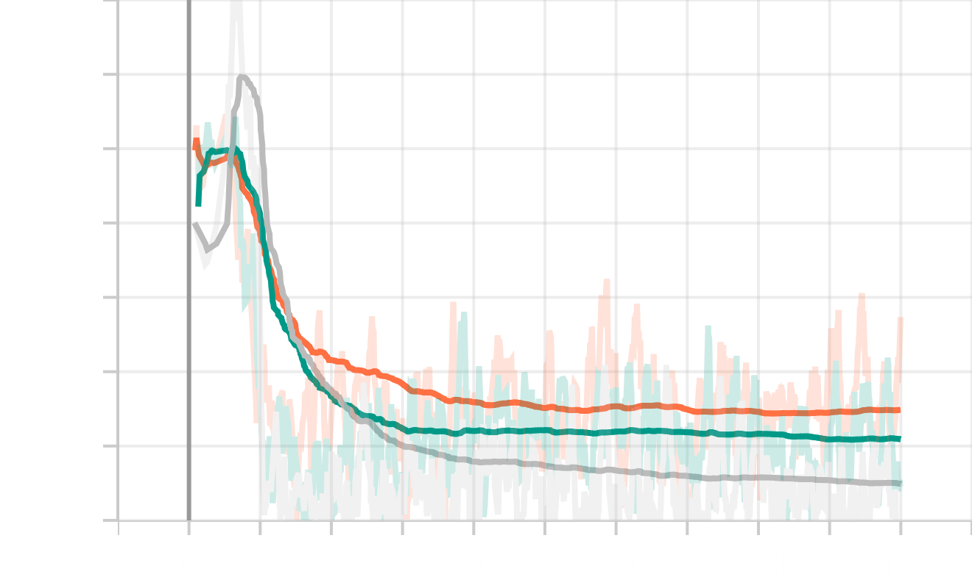
Learning Rate (DQN)
Orange 0.99; Green 0.5; Grey 0.001

Slide 7
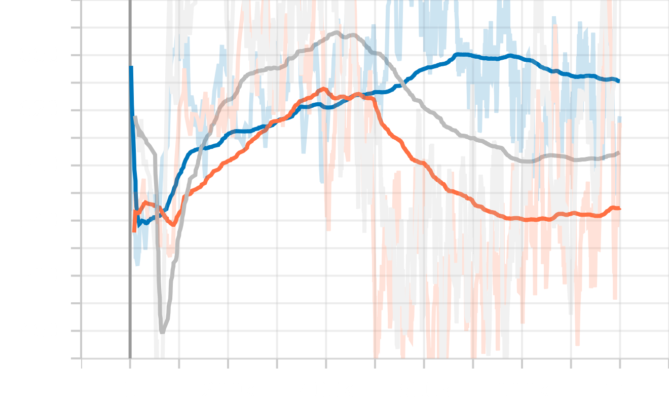
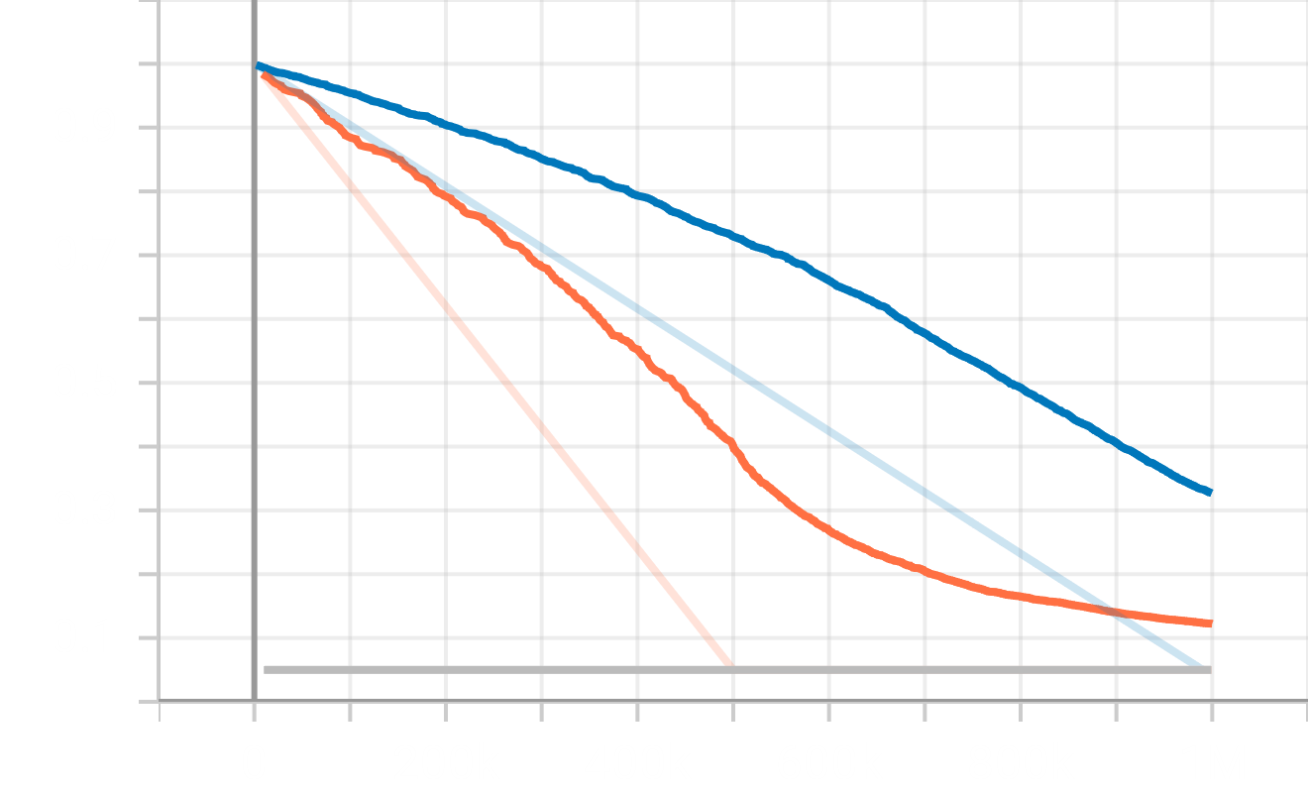
Exploration Fraction (DQN)
*PPO & A2C seems use different strategy of exploration
And do not support current environment or game
Blue 0.99; Grey 0.001;Orange 0.5
Reward
Exploration Fraction

Slide 8
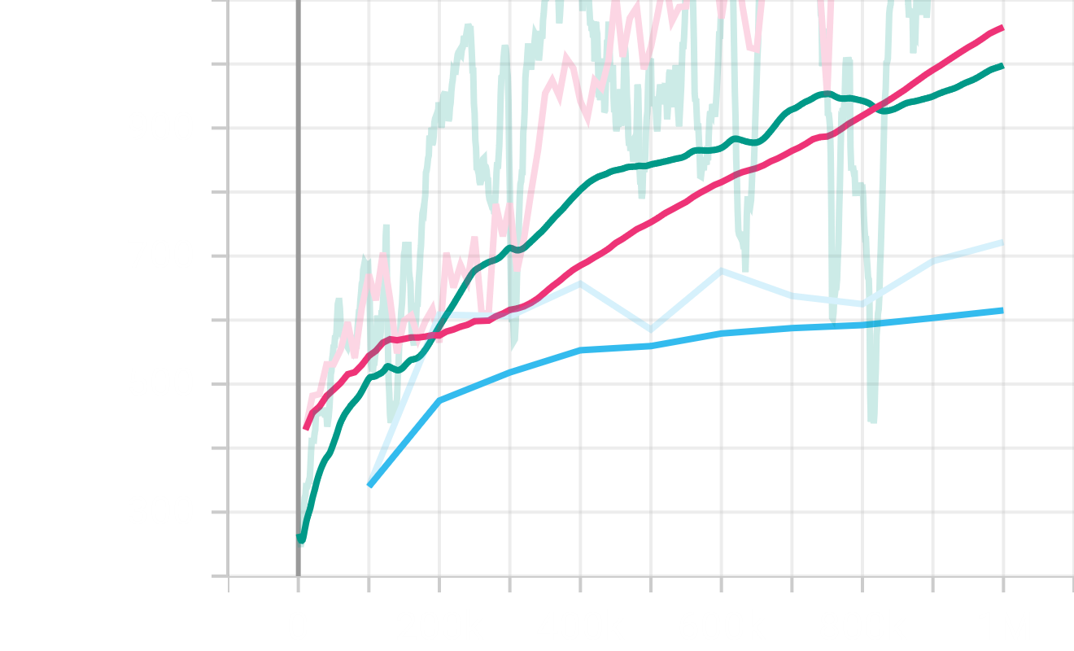
Step (A2C)
Light Blue 1000; Pink 100; Grey 10

Slide 9
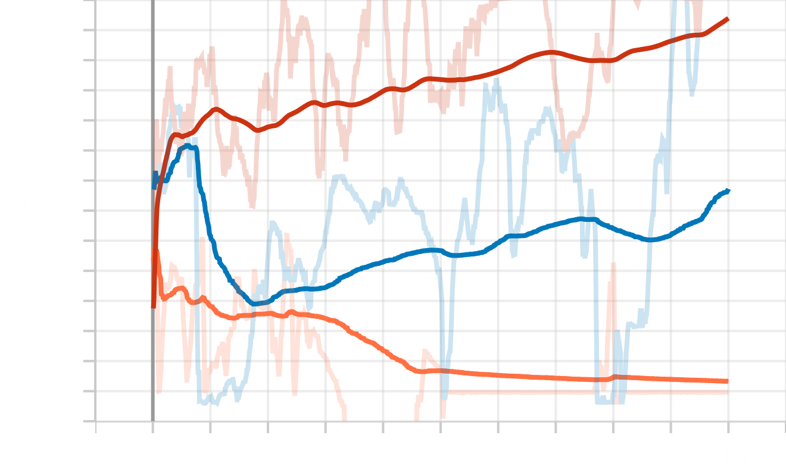
Step (PPO)
Red 1000; Blue 100; Orange 10

Slide 10
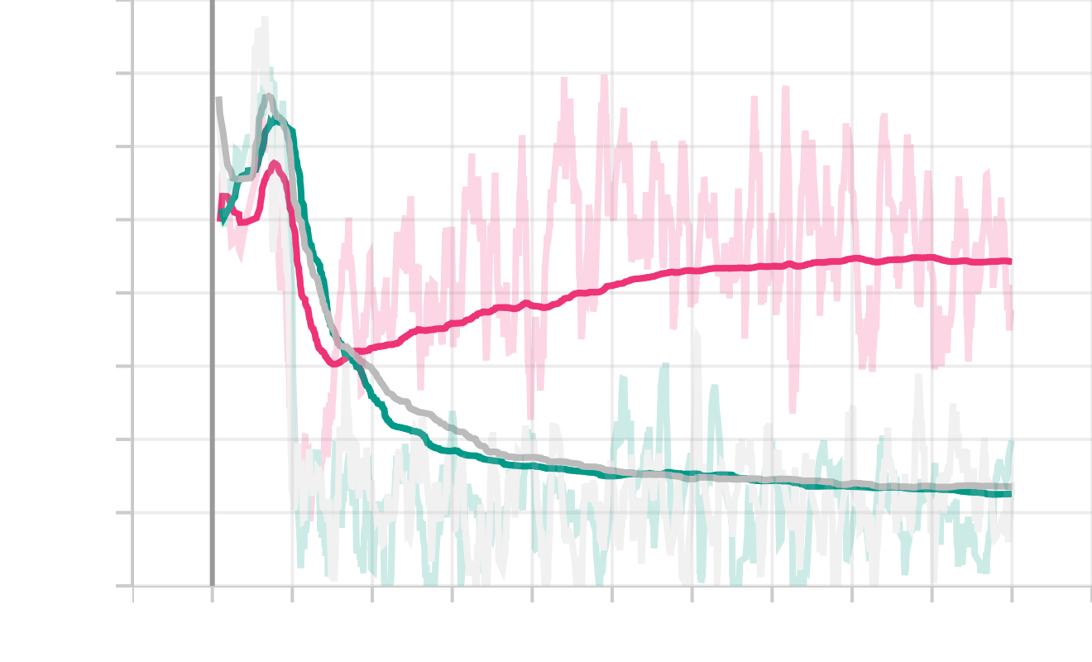
Step (DQN)
Pink 10; Green 100; Grey 1000

Slide 11
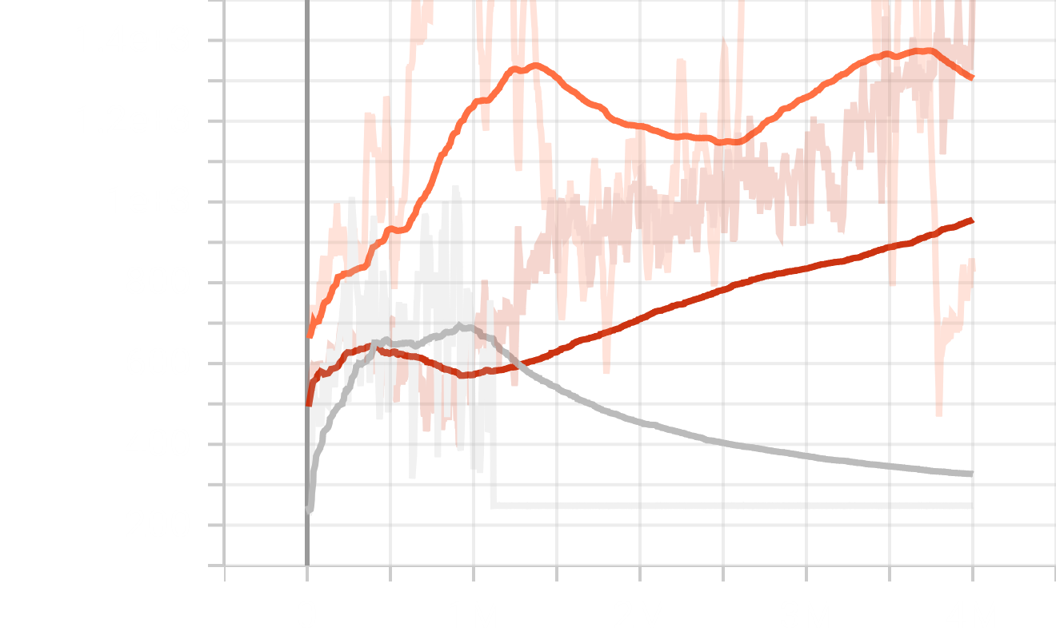
4M baseline
Grey A2C; Orange PPO; Red DQN

Slide 12
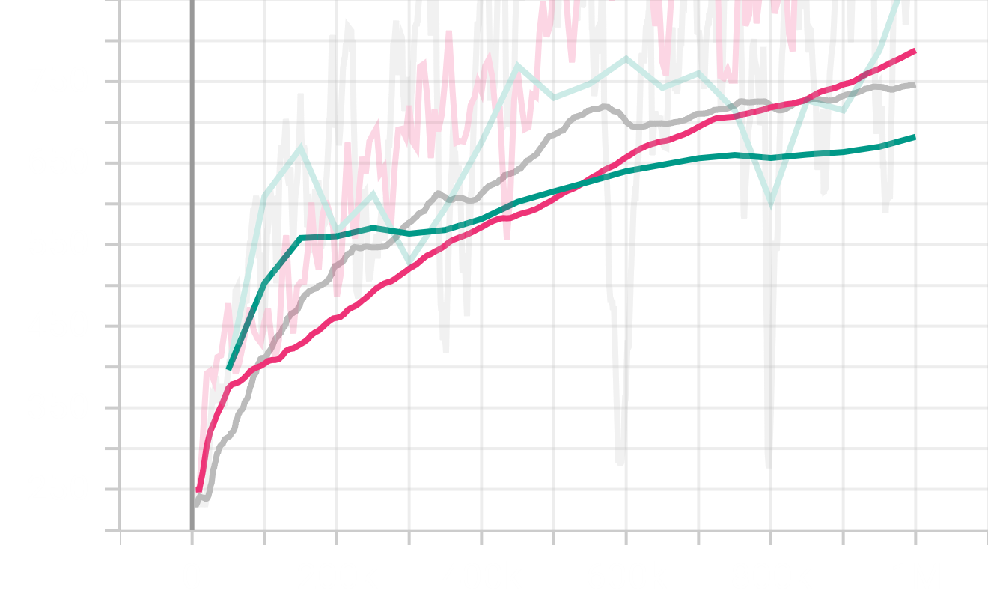
Multi Agent in testing (A2C)
Red 10; Grey 1; Green 100

Slide 13
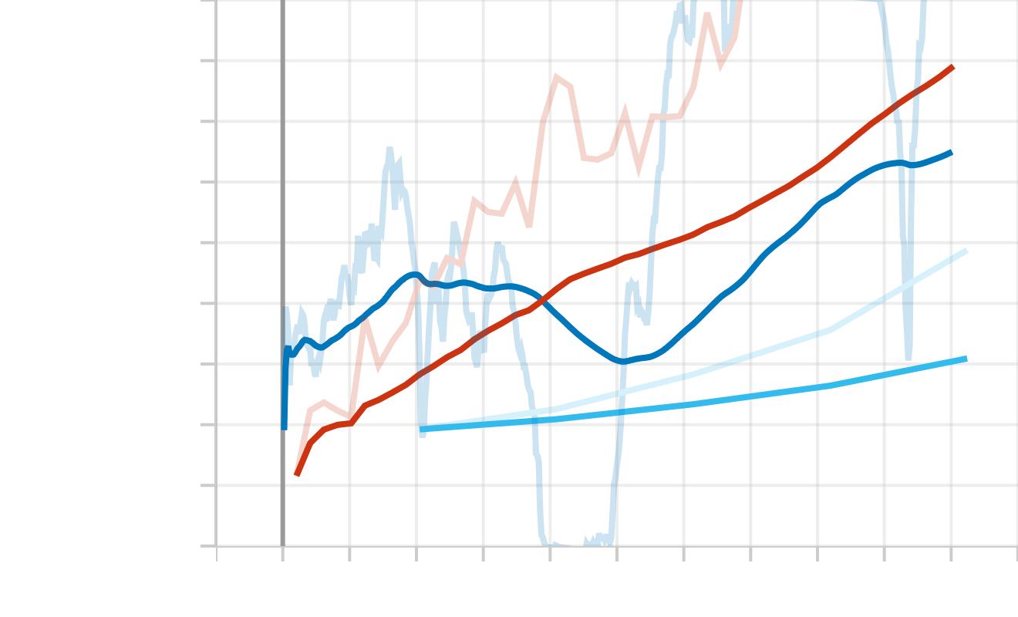
Multi Agent in testing (PPO)
Blue 10; Red 1; Light Blue 100

Slide 14
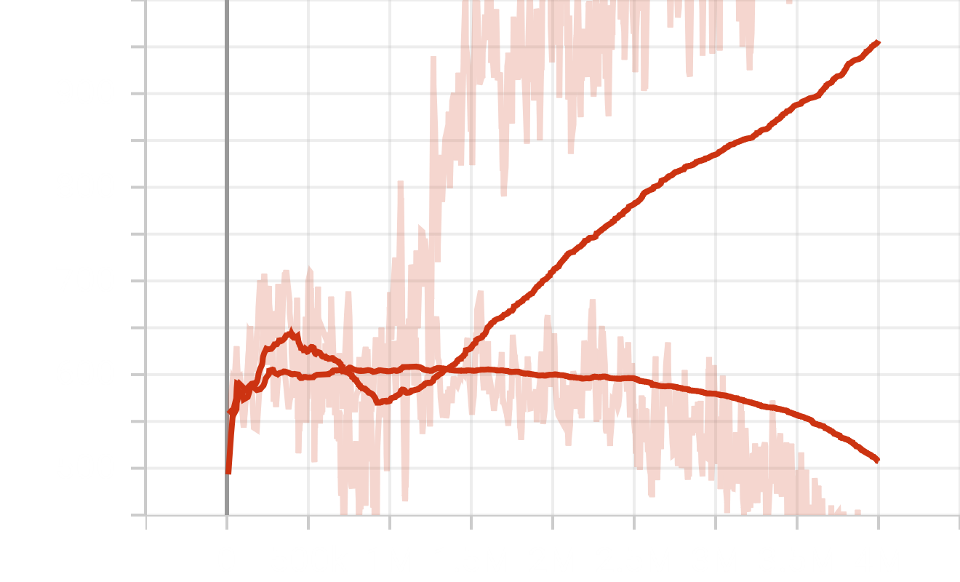
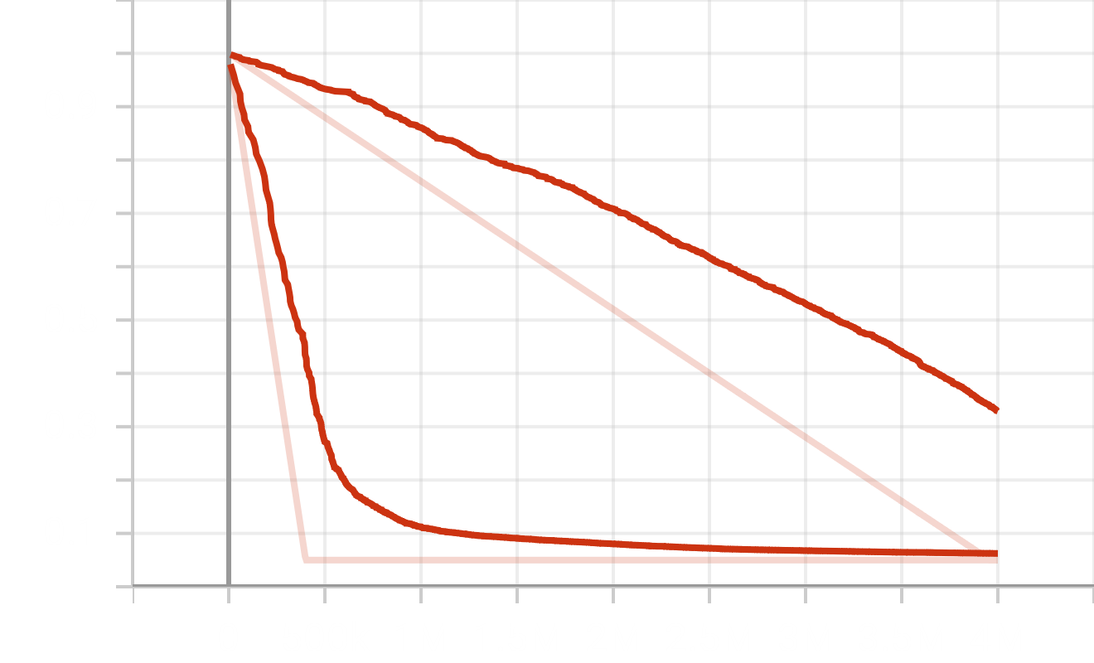
4M best parameter in testing (DQN)
Higher one Default Parameter

Slide 15
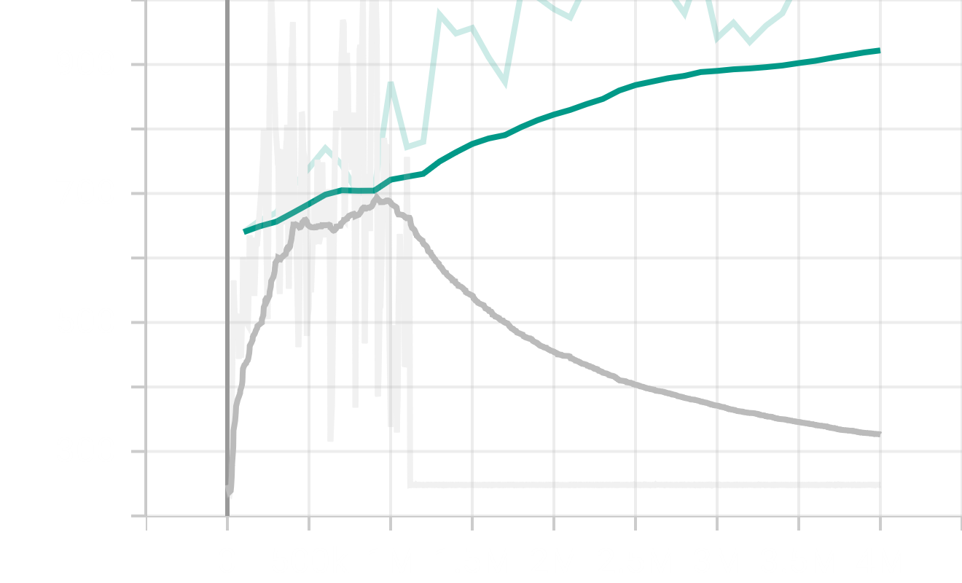
4M best parameter in testing (A2C)
Higher one Best Parameter

Slide 16
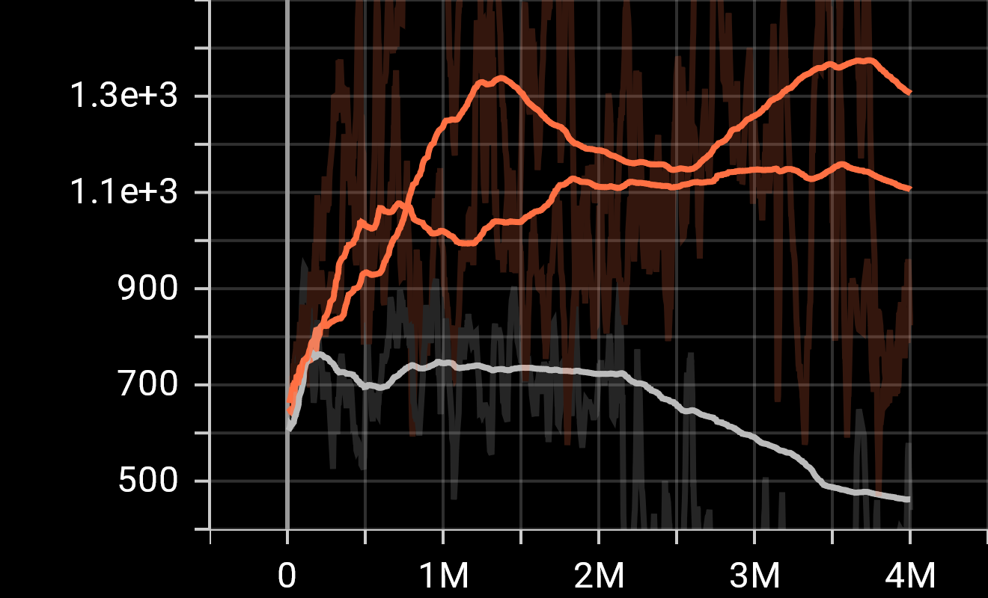
4M best parameter in testing
Higher one Default
BC_1: the one with default Learning Rate
BC: “Best” Parameter

